Slide 1


Slide 2
About AAA
“Since 2004, Annapolis Arts Alliance has connected artists, organizations, and the community through programs, partnerships, and opportunities that strengthen the arts throughout our region”

Slide 3
Mission
"To nurture artists, expand access to the arts, and inspire lifelong engagement through creativity, education, and community connection.”

Slide 4
Vision
“A vibrant community where everyone can create, experience and benefit from the arts.”

Slide 5
Core Concept
Support artists at every stage of their creative journey
Expand access to meaningful arts experiences
Remove barriers to participation
Strengthen community through creativity
Ensure the arts remain a vital part of civic life

Slide 6
Core Values
Support freedom of artistic expression
Encourage innovation in traditional, emerging and underrepresented art forms.
Promote participation in and learning about art as a lifelong endeavor.
Actively identify and eliminate barriers to engagement in the arts.

Slide 7
Core Values
Provide resources, opportunities, and access to individuals underrepresented in the art community.
Cultivate trust through respect, honesty, and transparency.
Manage resources to ensure the viability, growth, and sustainability of the Annapolis Arts Alliance.

Slide 8
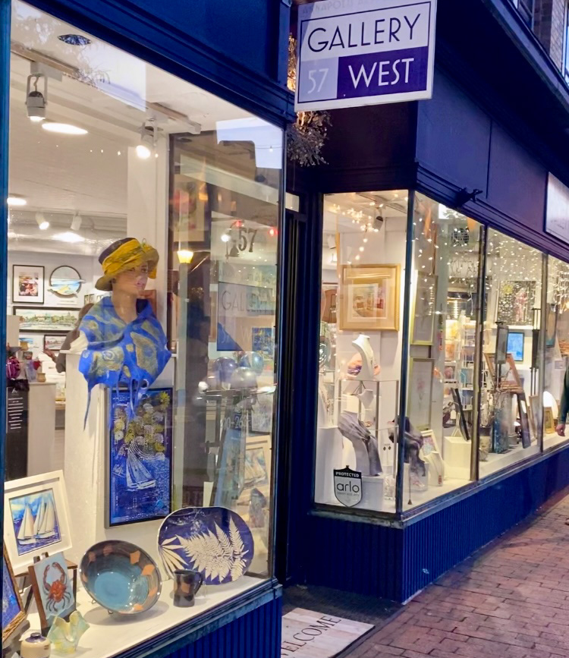
Core Programs
Gallery 57 West
Voted 2026 Best Gallery
Provides a collective venue, voice, and forum to support members of the arts community and offer opportunities to for artists to collaborate with each other and polish creative skills.

Slide 9
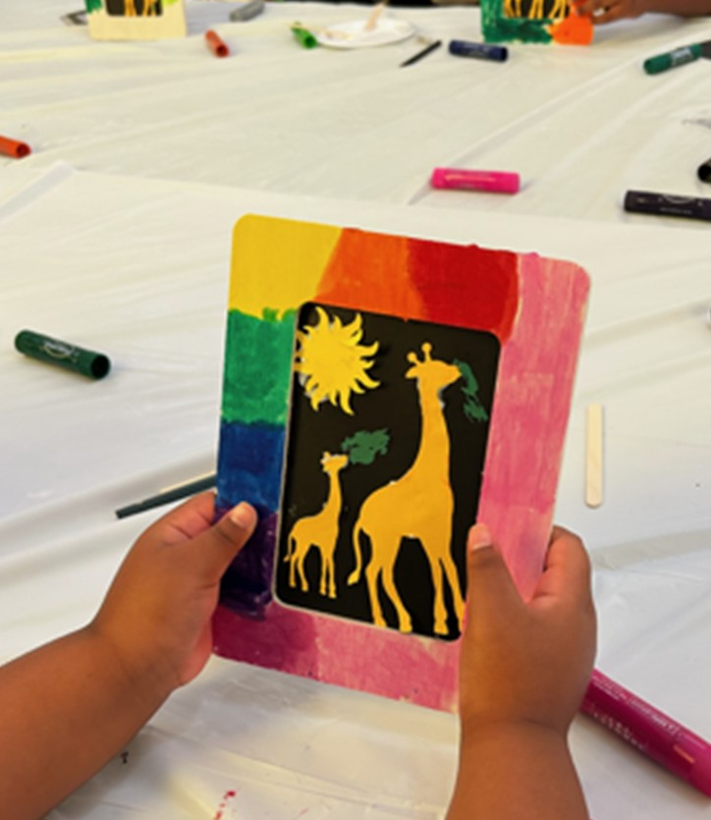
Core Programs
Art Buddies
Developed to nurture and strengthen an appreciation for the arts in elementary and middle school aged children in communities with limited access to the arts – AAA Collaborated with a local community organization and a local church to offer 6 programs in the past 18 months.

Slide 10
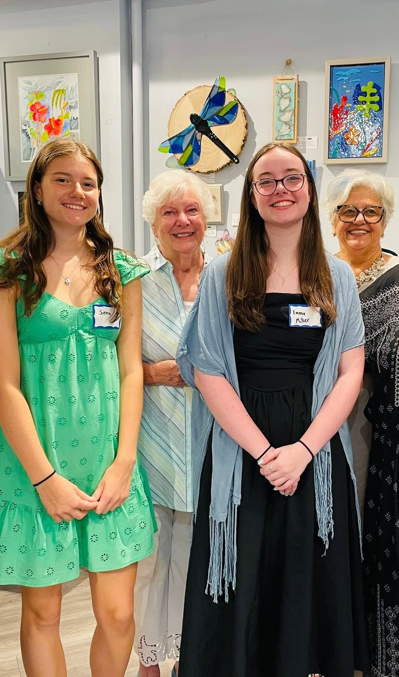
Core Programs
Scholarship Program
Established in 2021- Awarded 17 scholarships totaling $32,500

Slide 11
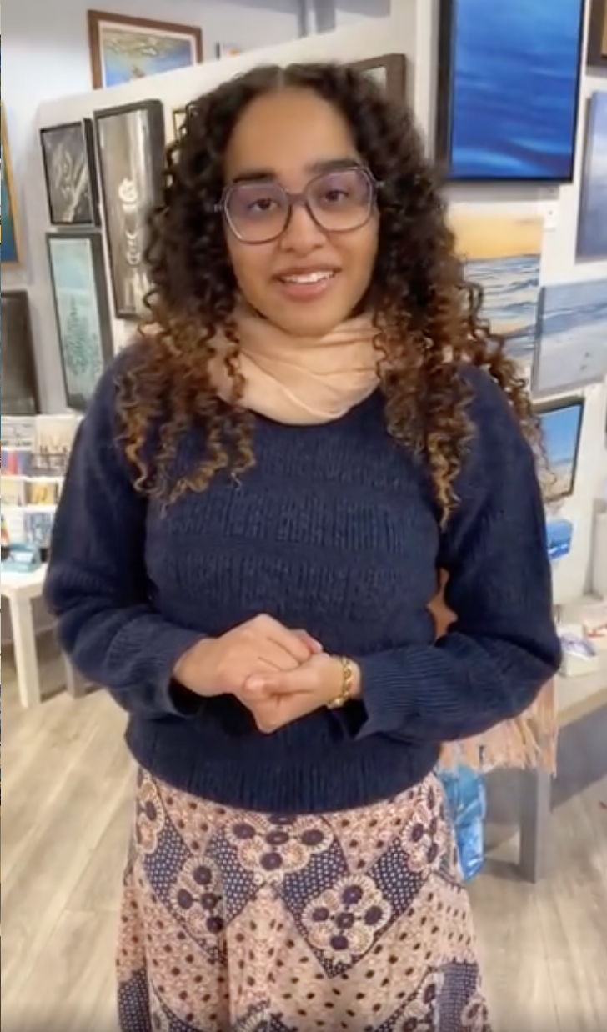
Core Programs
Internship Program
To provide an opportunity and forum for communications and marketing students to polish skills, learn new skill and develop unique communication and marketing tools that promote artistic programs and support artists.

Slide 12
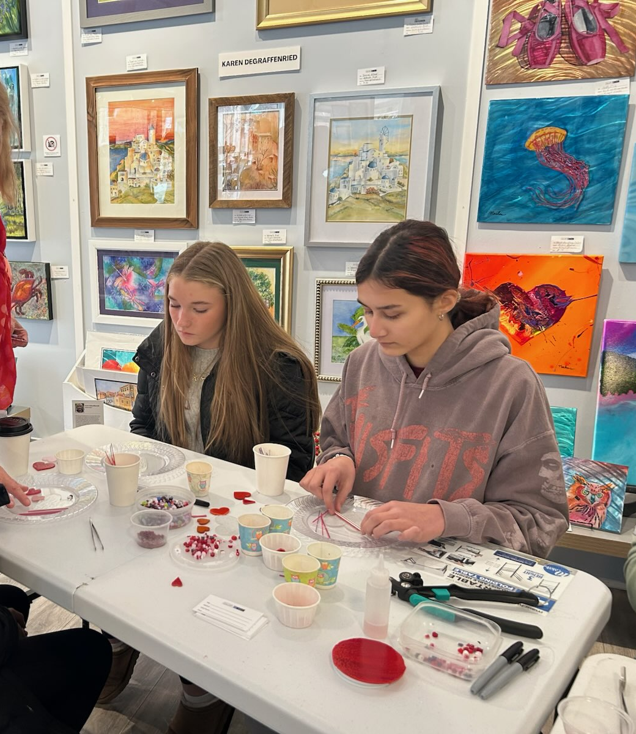
Core Programs
Art Hub
Expands equitable access to creative space for artists, small arts organizations, guilds, educators, and community groups who often face barriers to affordable and visible venues.
The Art Hub at Gallery 57 West has sponsored three artist workshops in the 2nd quarter of 2026.

Slide 13
Board of Directors
Governance, oversight, strategic planning “Volunteer leaders dedicated to advancing the mission and strengthening the arts community.”
OFFICERS
Jessica McGrath Terry Bydume
DIRECTORS
Bob Bloom Selma Manizade
Barbara Burns Stephanie Raymer
Jessica Cicoria Mary Rosoff
JoAnn Cook Anastasia Samaras
Brooklyn Haugh Kathy Strouss

Slide 14
Strategic Priorities 2026–2027
Grow Our Community
Expand Access
Develop Leadership
Increase Visibility

Slide 15
Strategic Priorities 2026–2027
Communication
Enhance the Alliance’s, visibility, engagement, and community impact through clear, consistent, and strategic external communications across all platforms.

Slide 16
Art Hub Initiative
Expand to emphasize community impact:
  Exhibitions
  Workshops
  Artist Talks
  Partnerships
  Accessible Arts Programming

Slide 17
Internship Expansion
Leadership and Skills Development
Gallery Management
Marketing
Curation Experience

Slide 18
Executive Director Initiative
Recruit and retain a part-time Executive Director
Operational support
Fundraising
Partnership development
Organizational sustainability

Slide 19
Long-Term Vision
An environment where artists thrive
Creative opportunities that are accessible to all.
Flourishing community partnerships.
Strethening the community through art.

Slide 20
Upcoming Artist Opportunities
Emerging Artist Exhibits
Exhibitions – Maritime Museum, Petite Squares
Artist Hosted Workshops
Artist Talks

Slide 21
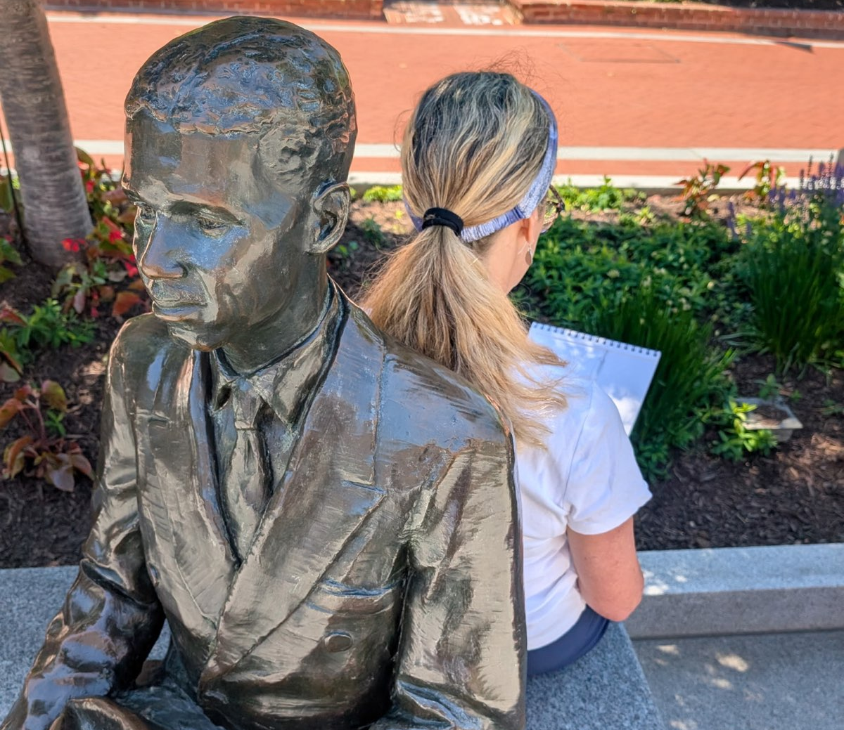
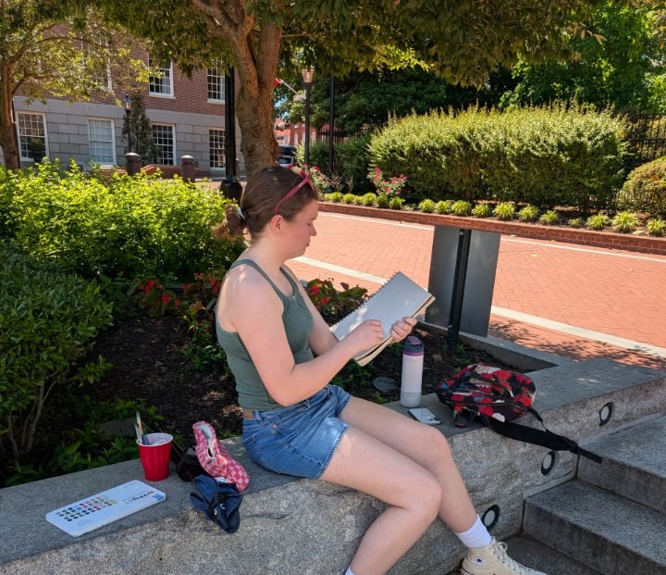
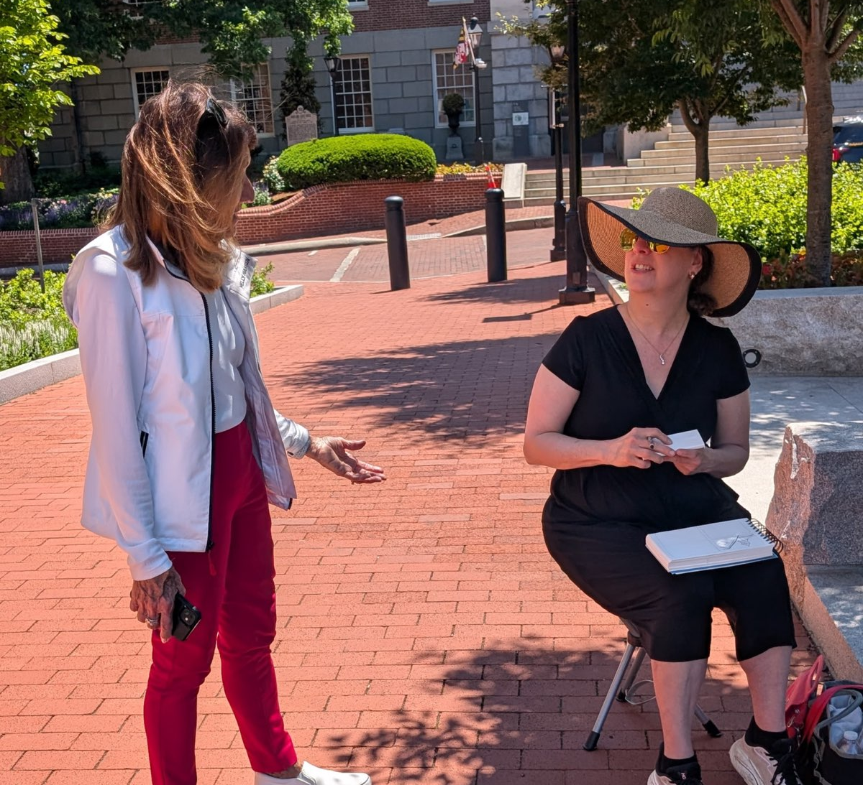
A Look Back
2025 -2026 EVENTS
AACC Student Art Exhibition
Artist Talks
Busch Library Exhibit Member Show
Faux-to-Booth
HER Exhibition
Petite Squares Exhibition
Poetry of Pictures
Pumpkins for a Cause
Quiet Waters Gallery Member Show
Sketch Crawl
Toy Drive

Slide 22
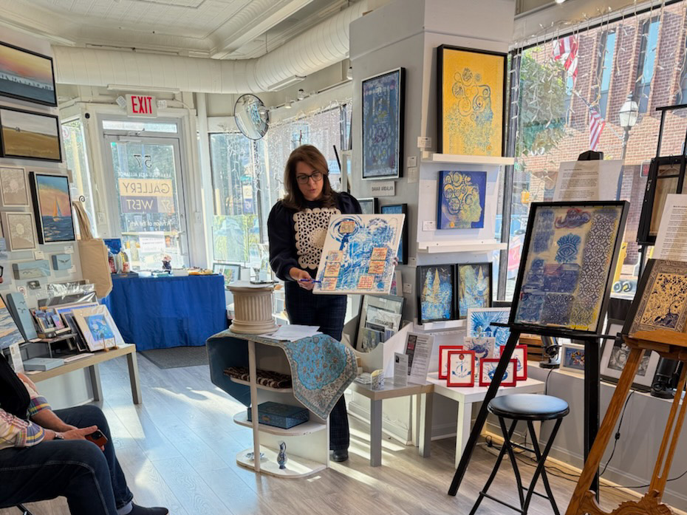
ARTIST TALK

Slide 23
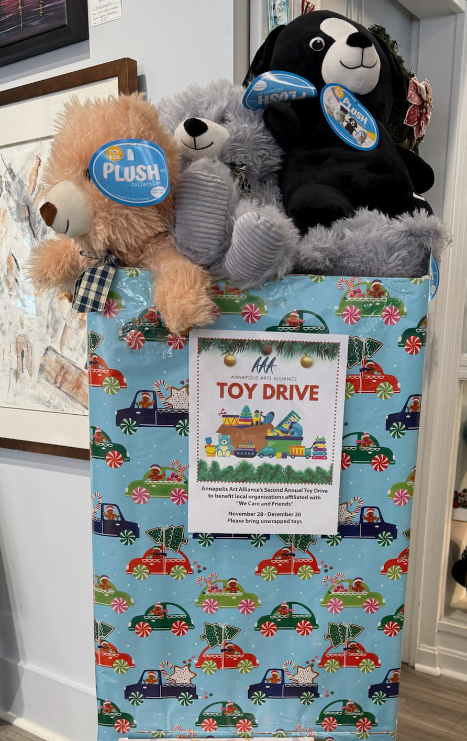

Slide 24
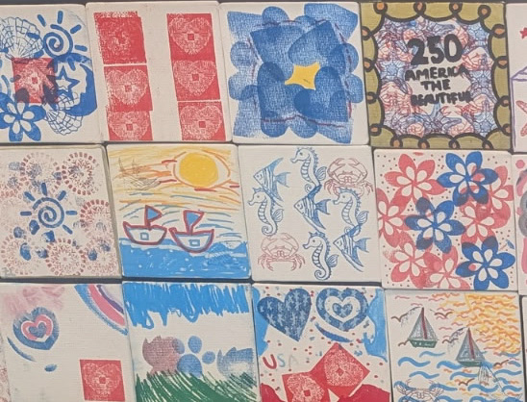

Slide 25
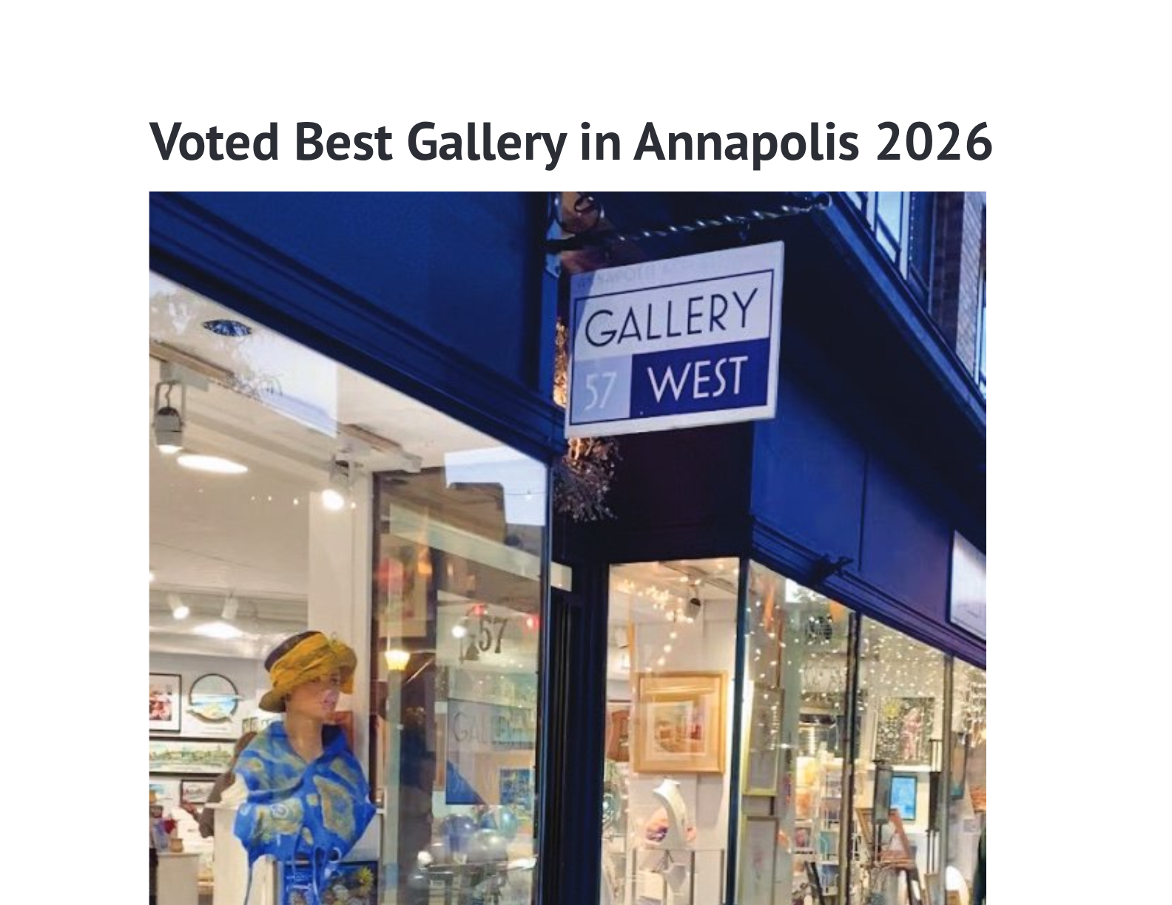

Slide 26
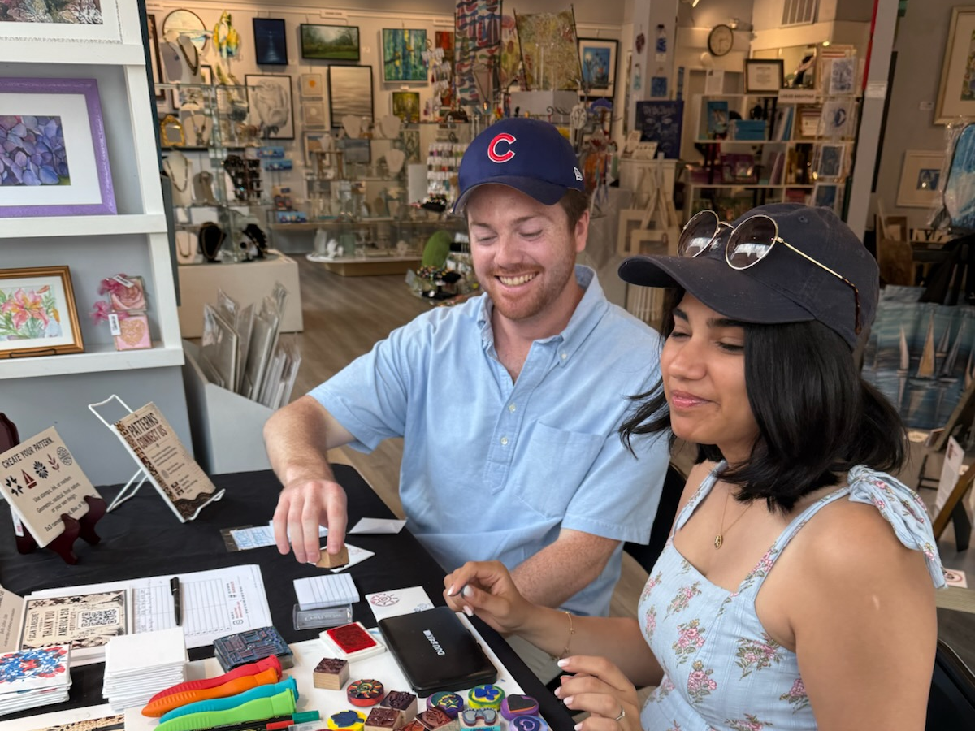
AMERICA 250

Slide 27
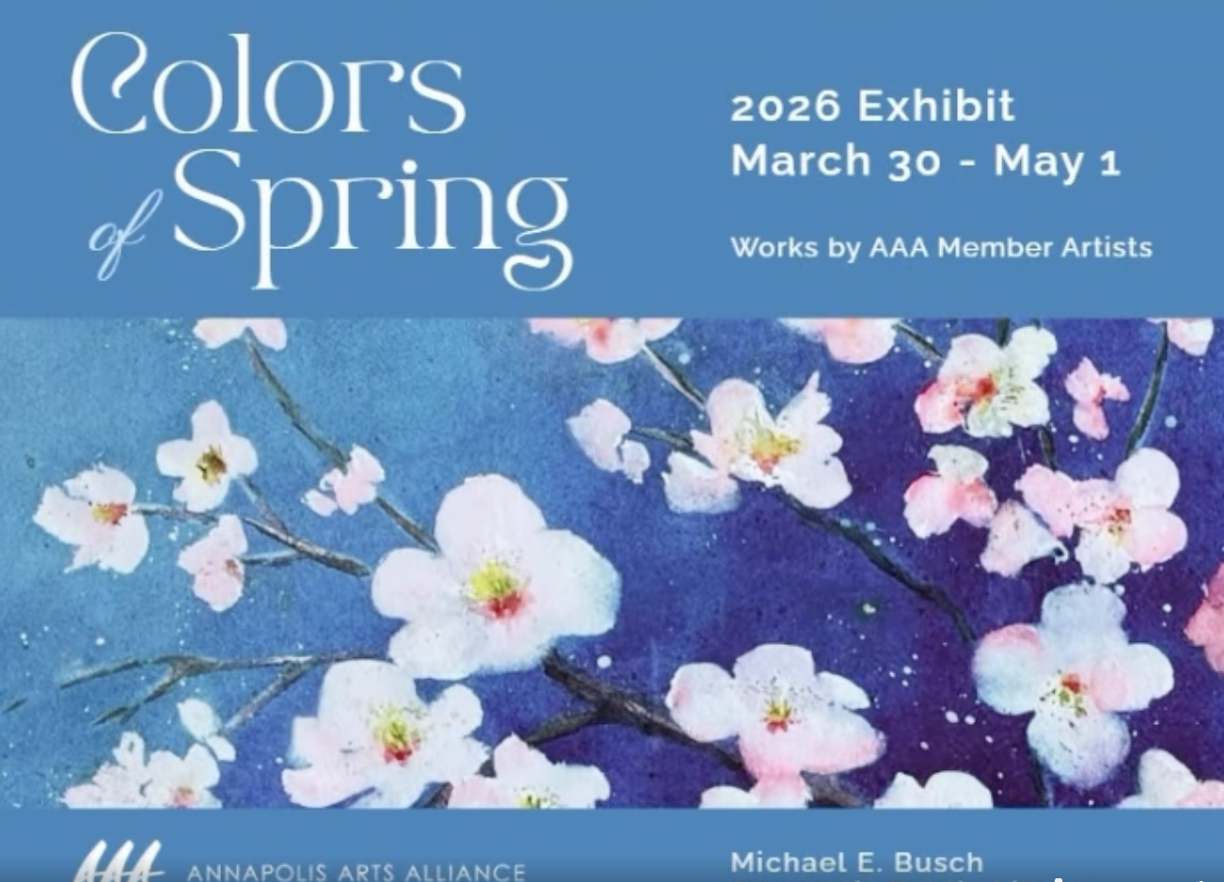

Slide 28
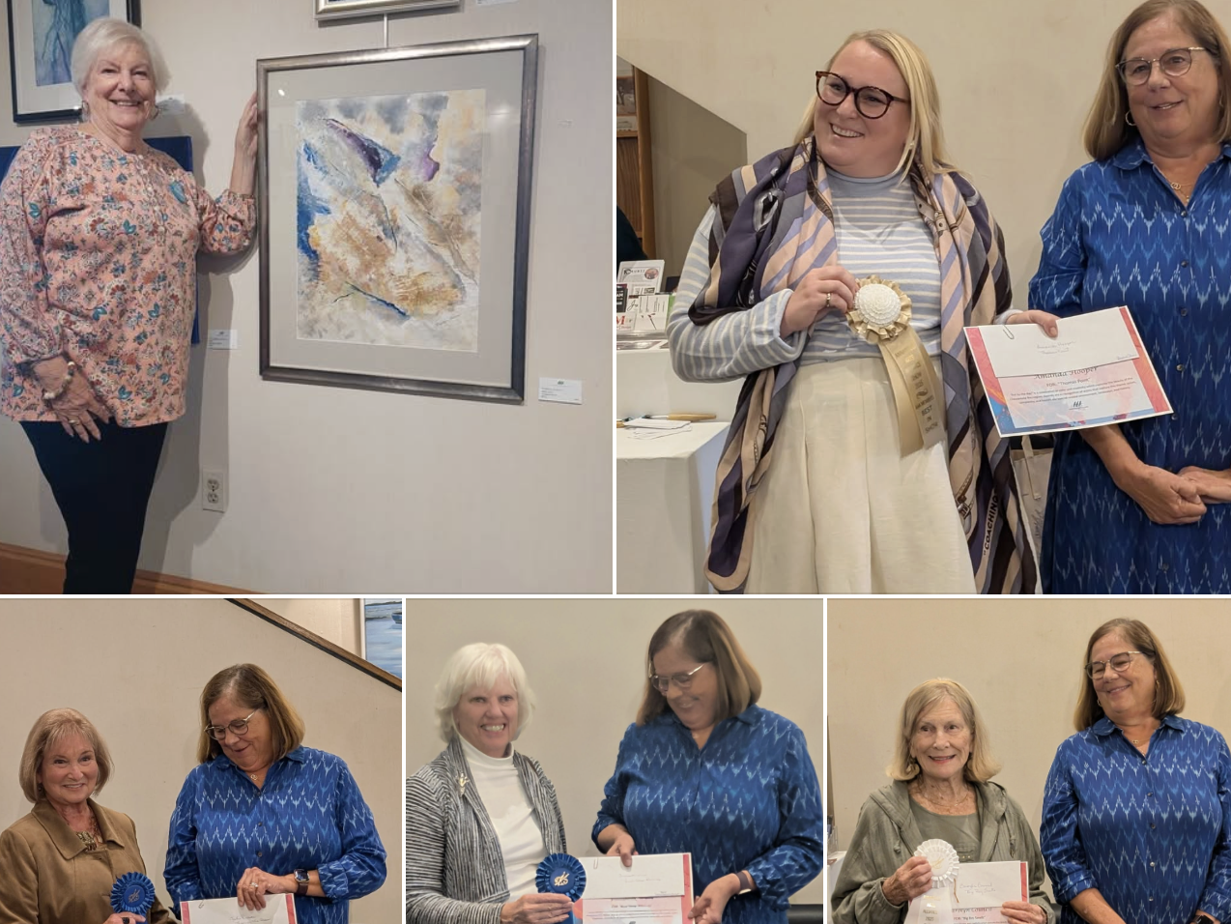
QUIET WATERS EXHIBIT

Slide 29
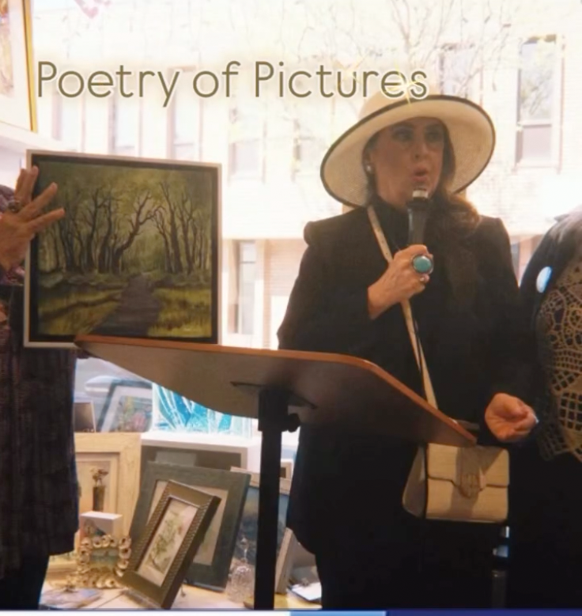

Slide 30
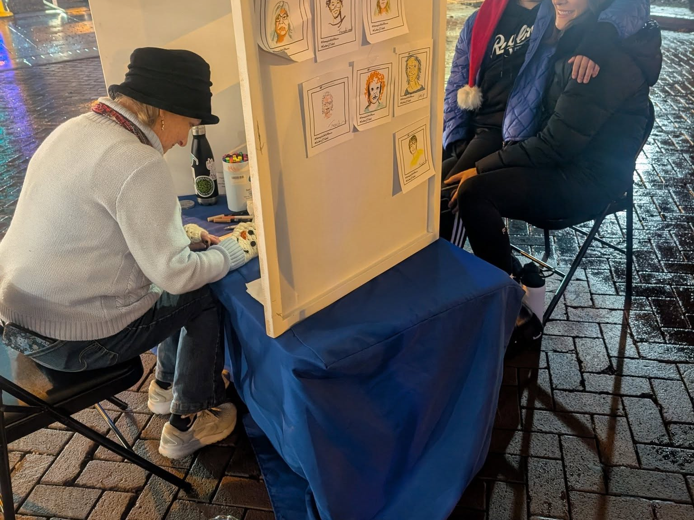
FAUX-TO-BOOTH

Slide 31
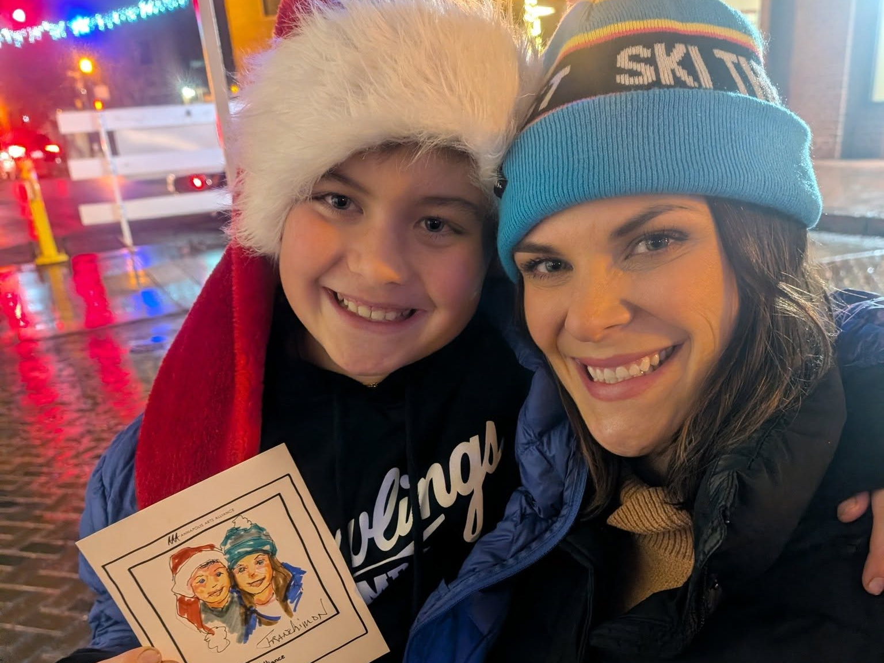
FAUX-TO-BOOTH

Slide 32
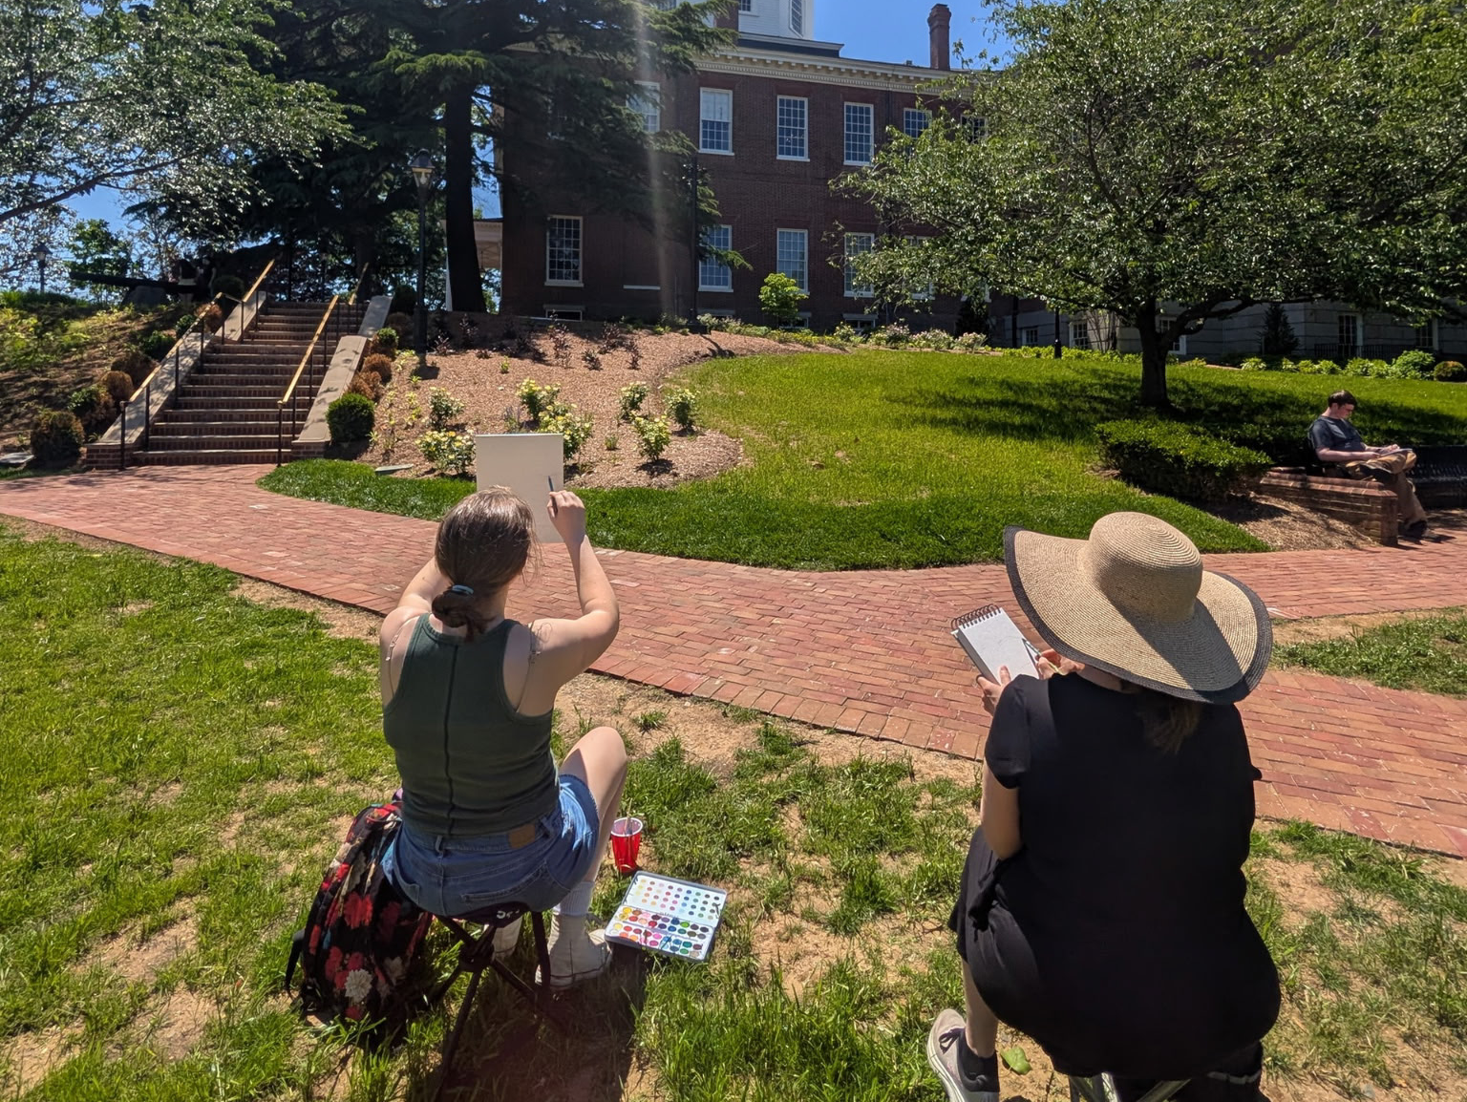
SKETCH CRAWL

Slide 33
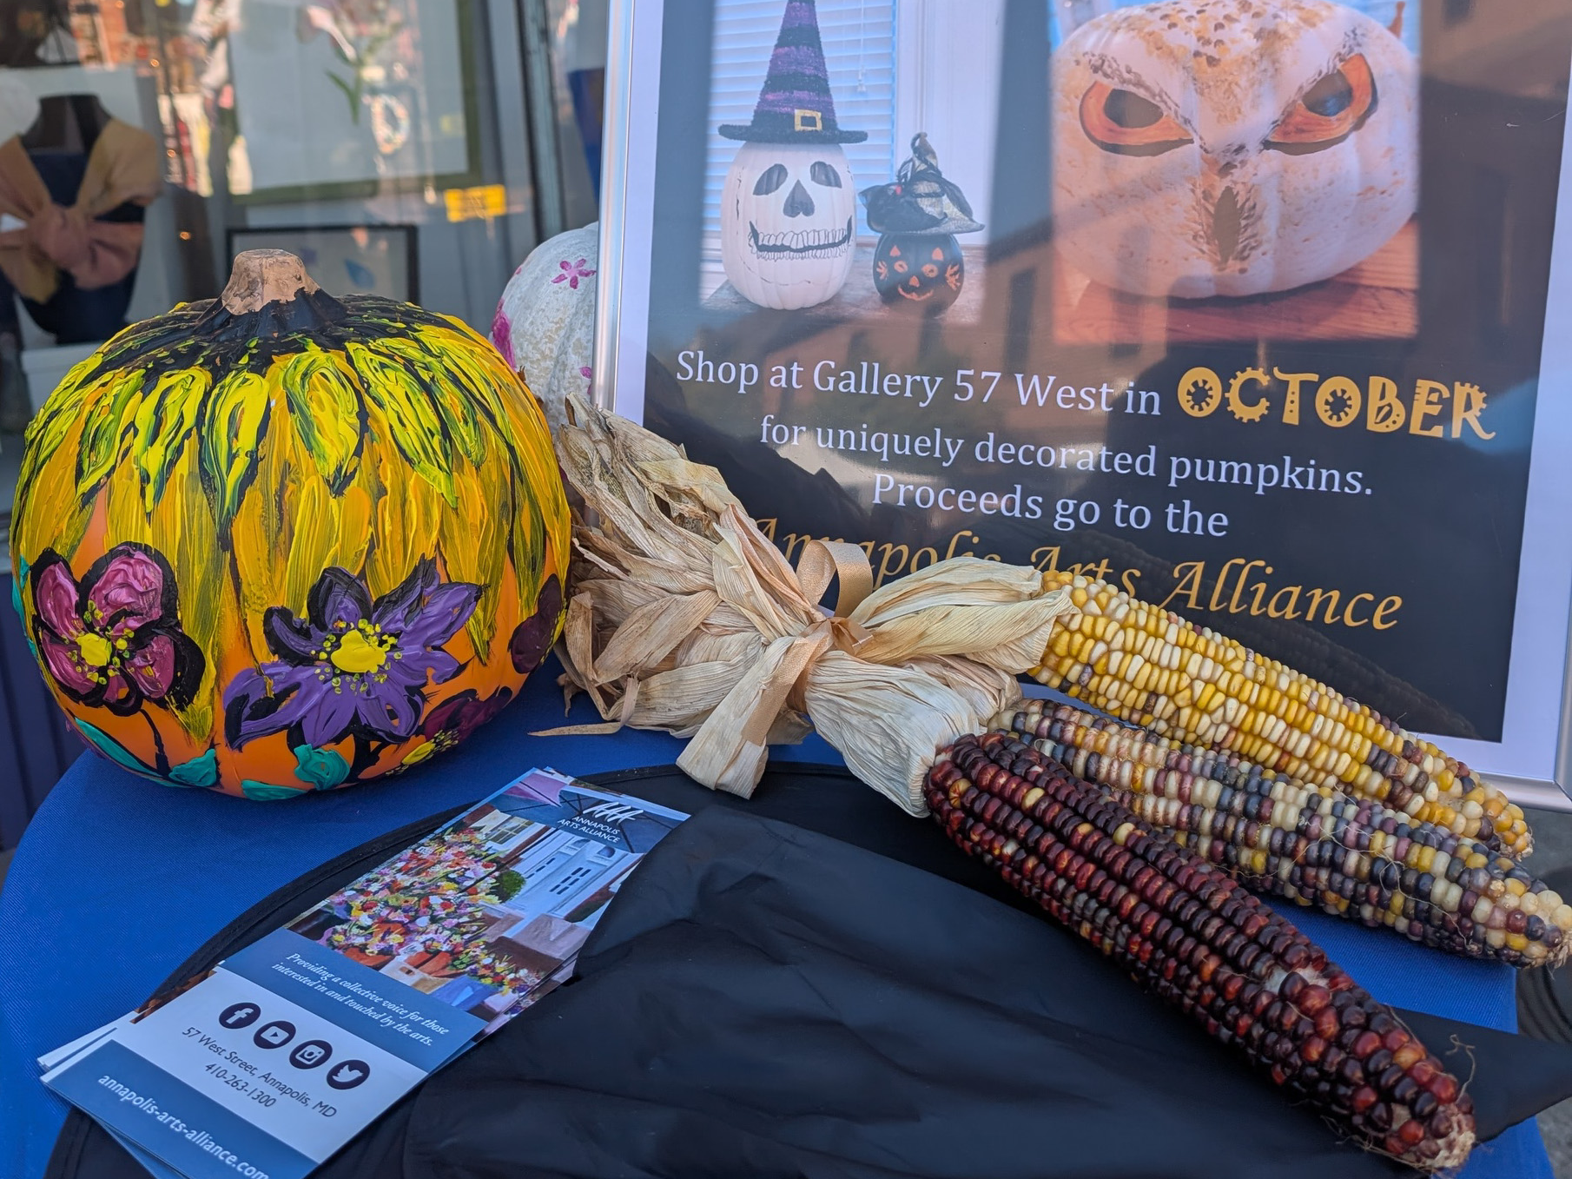
PUMPKINS FOR A CAUSE

Slide 34
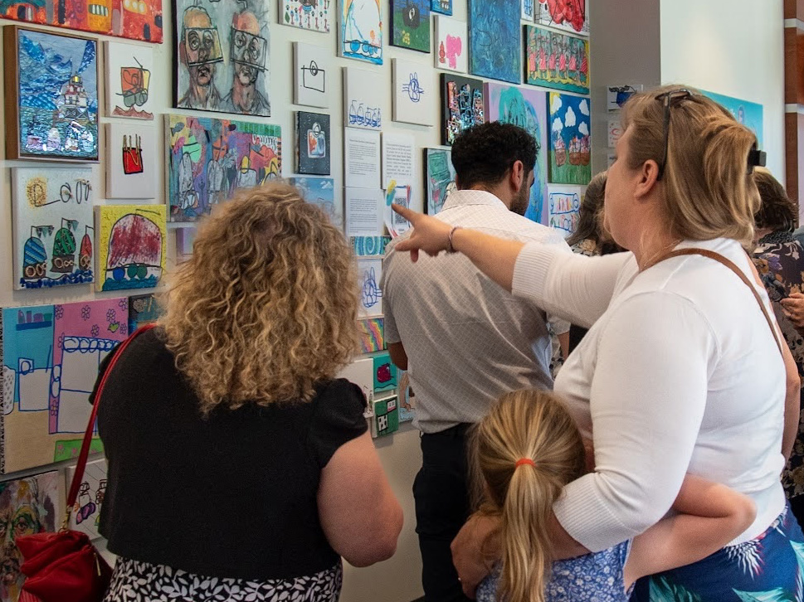
FUNDRAISING EXHIBIT

Slide 35
THANK YOU
To all who made this past 18 months possible.
  You saw the vision
  You believed in the possibilities
  You worked tirelessly

